Slide 1
ENGR 1400
Dr. Michael E. Olson
Snow College

Slide 2
Welcome to Programming Fundamentals!
Introductions
What we will be learning
What programming languages are there?
How to install software
Helps for learning C++
Our textbook and course schedule
How to prepare for each lecture
How you will be graded in this course

Slide 3
Chapter 1 Introduction to computers and programming
Starting Out with C++ from Control Structures through Objects, Tony Gaddis, 9th Edition
ENGR 1400 – Dr. Michael E. Olson

Slide 4
1.1
Why Program?

Slide 5
Why Program?
Computer – programmable machine designed to follow instructions (aka hardware)
Program – instructions in computer memory to make it do something (aka software)
Programmer – person who writes instructions (programs) to make computer perform a task
SO, without programmers, no programs; without programs, a computer cannot do anything

Slide 6
Where do we use programming?
Business
Medicine
Government
Law enforcement
Agriculture
Academia
Entertainment
Anywhere a computer is used
…that is, everywhere!

Slide 7
Where do we use programming?
Here at Snow College, we have a software engineering degree, focusing on:
Entrepreneurship
Digital Media Design
Web Development
Data Science
All types of Engineering require some type of software

Slide 8
What is Programming
An art
Program are carefully designed
A flow of instructions
Math Procedures
Appearance
Presentation
User-friendliness
Documentation
A science
Programs rarely work right the first time
Programming requires
Testing
Correction
Redesigning
Testing
Correction
Redesigning
…
(Scientific Method?)

Slide 9
1.2
Computer Systems: Hardware and Software
Notes:
Hardware: The physical components of which a computer is made.
Each piece plays a role in the computation process

Slide 10
Main Hardware Component Categories:
Central Processing Unit (CPU)
Main Memory
Secondary Memory / Storage
Input Devices
Output Devices
Notes:
CPU is what runs or executes the program – the most important

Slide 11
Central Processing Unit (CPU)
Where the computation happens (thus most important part?)
First programmable Computer: ENIAC
Vacuum Tubes used to process information
Filled (1) or vacuum (0)

Slide 12
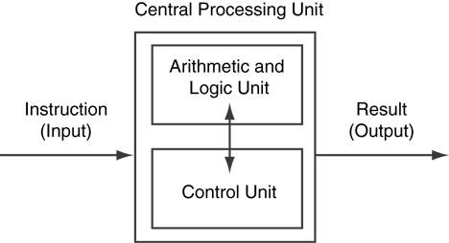
Central Processing Unit (CPU)
Comprised of:
Control Unit
Retrieves and decodes program instructions
Coordinates activities of all other parts of computer
Arithmetic & Logic Unit (ALU)
Hardware optimized for high-speed numeric calculation
Hardware designed for true/false, yes/no decisions
Figure 1-3

Slide 13
Main Memory
Organized as follows:
bit: smallest piece of memory. Has values 0 (off, false) or 1 (on, true)
“bit” is short (Bi)nary digi(t)
byte: 8 consecutive bits. Bytes have addresses.
Also called Random Access Memory (RAM)
RAM is volatile. Main memory is erased when program terminates or computer is turned off

Slide 14
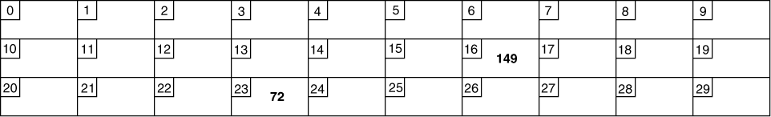
Main Memory
Addresses – Each byte in memory is identified by a unique number known as an address.

Slide 15
Secondary Storage
Comes in a variety of media:
magnetic: traditional hard drives that use a moveable mechanical arm to read/write
solid-state: data stored in chips, no moving parts
optical: CD-ROM, DVD
Flash drives, connected to the USB port
Non-volatile: data retained when program is not running or computer is turned off

Slide 16
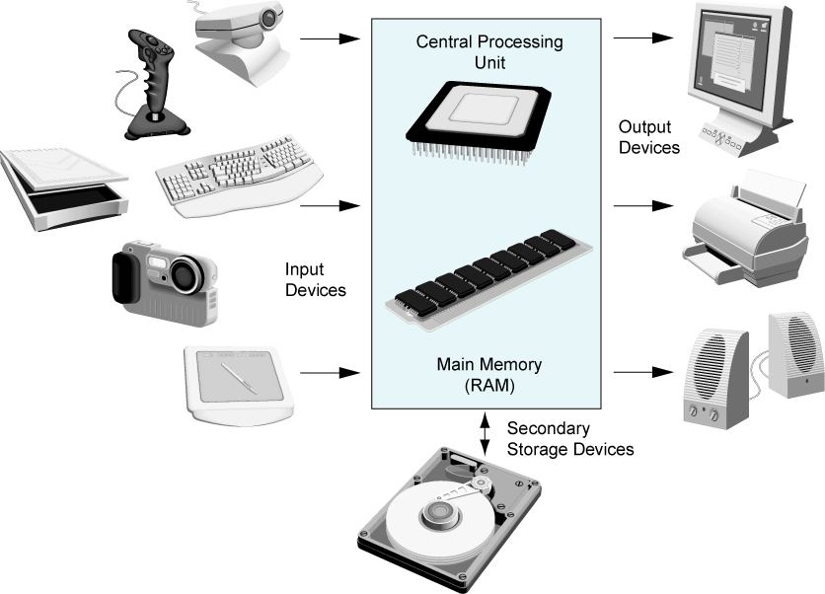
Main Hardware Component Categories
Figure 1-2

Slide 17
Software-Programs That Run on a Computer
Categories of software:
System software: programs that manage the computer hardware and the programs that run on them.
Examples: operating systems, utility programs, software development tools
Application software: programs that provide services to the user.
Examples : word processing, games, programs to solve specific problems

Slide 18
1.3
Programs and Programming Languages

Slide 19
Programs and Programming Languages
A program is a set of instructions that the computer follows to perform a task
We start with an algorithm, which is a set of well-defined steps.

Slide 20
Machine Language
Although our algorithm is well-defined, it is not ready to be executed on the computer.
The computer only executes machine language instructions

Slide 21
Machine Language
Machine language instructions are binary numbers, such as 1011010000000101
Rather than writing programs in machine language, programmers use programming languages.

Slide 22
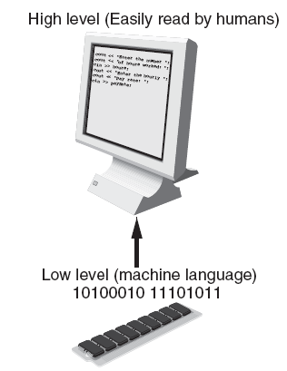
Programs and Programming Languages
Types of languages:
Low-level: used for communication with computer hardware directly. Often written in binary machine code (0’s/1’s) directly.
High-level: closer to human language

Slide 23
Some Well-Known Programming Languages
C++
BASIC
Ruby
Java
FORTRAN
Visual Basic
C#
Swift
COBOL
Rust
JavaScript
C
Python
Go

Slide 24
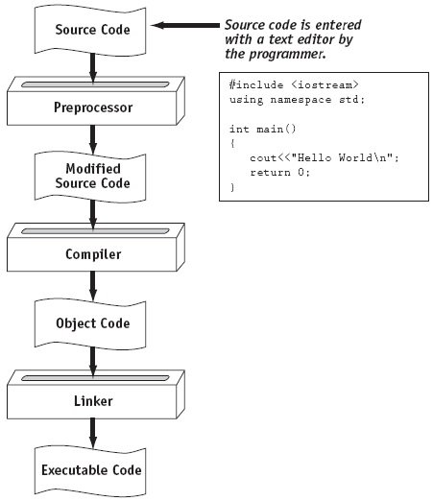
From a High-Level Program to an Executable File

Slide 25
Syntax and Logical Errors
When the compiler runs through the steps, it can uncover syntax errors
Syntax errors are illegal uses of key words, operators, punctuation, and other language elements
Compilers will not catch logical errors
Logical errors are mistakes that cause the program to produce erroneous results

Slide 26
Integrated Development Environments (IDEs)
An integrated development environment, or IDE, combines all the tools needed to write, compile, and debug a program into a single software application.
Examples are Microsoft Visual C++, VisualStudio, Turbo C++ Explorer, CodeWarrior, etc.

Slide 27
1.4
What is a Program Made of?

Slide 28
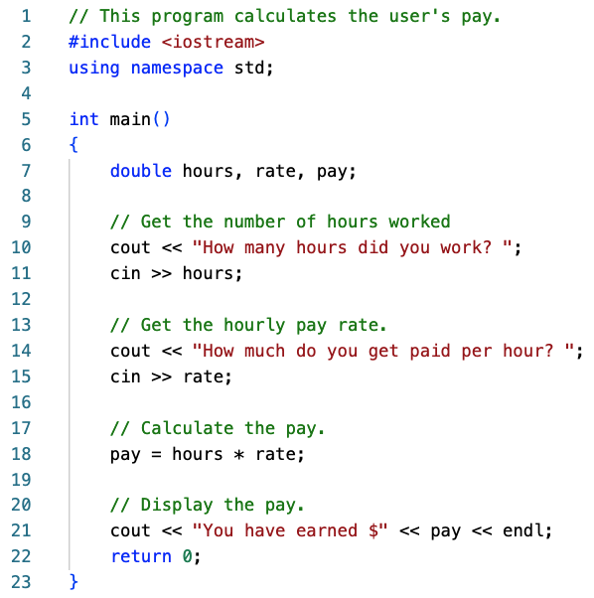
What is a Program Made of?
Common elements in programming languages:
Key Words
Programmer-Defined Identifiers
Operators
Punctuation
Syntax

Slide 29
Key Words
Also known as reserved words
Have a special meaning in C++
Can not be used for any other purpose
Key words in the Program:
using, namespace, int, double, and return

Slide 30
Programmer-Defined Identifiers
Names made up by the programmer
Not part of the C++ language
Used to represent various things:
variables (memory locations),
hours, rate, and pay.
functions,
etc.

Slide 31
Operators
Used to perform operations on data
Many types of operators:
Arithmetic
+,-,*,/
Assignment
=, <<, >>, *

Slide 32
Punctuation
Characters that mark the end of a statement, or that separate items in a list
, and ;

Slide 33
Syntax
The rules of grammar that must be followed when writing a program
Controls the use of key words, operators, programmer-defined symbols, and punctuation

Slide 34
Variables
A variable is a named storage location in the computer’s memory for holding a piece of data.
In Program 1-1 we used three variables:
The hours variable was used to hold the hours worked
The rate variable was used to hold the pay rate
The pay variable was used to hold the gross pay

Slide 35
Variable Definitions
To create a variable in a program you must write a variable definition (also called a variable declaration)
Here is the statement from Program 1-1 that defines the variables: double hours, rate, pay;

Slide 36
Variable Definitions
There are many different types of data, which you will learn about in this course.
A variable holds a specific type of data.
The variable definition specifies the type of data a variable can hold, and the variable name.

Slide 37
Variable Definitions
Once again, line 7 from Program 1-1: double hours, rate, pay;
The word double specifies that the variables can hold double-precision floating point numbers. (You will learn more about that in Chapter 2)

Slide 38
1.5
Input, Processing, and Output

Slide 39
Input, Processing, and Output
Three steps that a program typically performs:
Gather input data:
from keyboard
from files on disk drives
Process the input data
Display the results as output:
send it to the screen
write to a file

Slide 40
1.6
The Programming Process

Slide 41
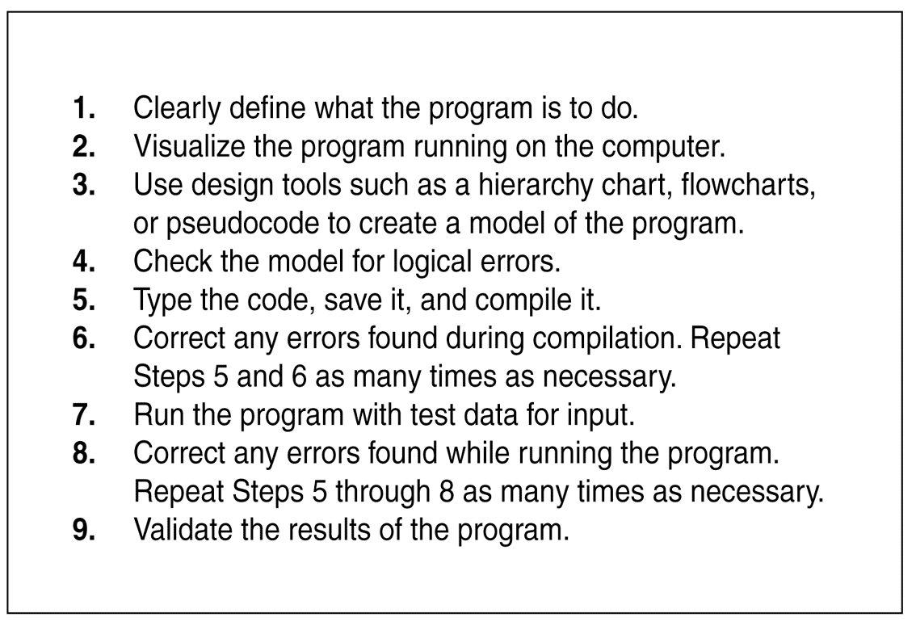
The Programming Process
Notes:
Create algorithm and code for:
* How many possible outcomes for two dice with varying sides (for example, how many outcomes are there when rolling a 12-sided die and a 4-sided die?)

Slide 42
The Programming Process
The first 4 steps are the most important. This is where you create your algorithm.
Creating the proper algorithm is practically what Computer Science is all about.
Notes:
Steps 1-4 are the most critical. This is where the program takes shape. The rest just tells the computer what to do.
* 80%-90% of programming is really in planning the algorithm and debugging
* 10%-20% is actually writing the program
__Computer Science__ is the study of creating proper algorithms.
__Software Engineering__ encompasses the whole process of crafting computer software. Tools used include
* Program specifications
* Charts and Diagrams of screen output
* Hierarchy charts and flowcharts
* Pseudocode
* Examples of expected input and desiredd output
* Special software designed for testing programs

Slide 43
1.7
Procedural and Object-Oriented Programming

Slide 44
Procedural and Object-Oriented Programming
Procedural programming: focus is on the process.
Procedures/functions are written to process data.
Object-Oriented programming: focus is on objects, which contain data and the means to manipulate the data.
Messages sent to objects to perform operations.

